Slide 1
Updated: 09/23/2024
Industry Group:
Jay West, Executive Director
202-249-6407
Jay_West@americanchemistry.com
Media Contact:
Erich Shea, Communications Director
202-249-6510
Erich_Shea@americanchemistry.com
For More Information:
The Performance Fluoropolymer Partnership Website
ACC Website Page on PFP
ACC Website Page on Fluoropolymer Chemistry

Slide 2
Toolkit Components and Definitions
Identity: The mission, goals, and objectives of the Performance Fluoropolymer Partnership.
Conversation: Published perspectives on PFP and its mission.
Impact: Content and collateral developed by PFP on a variety of related topics.
Engagement: Statements, correspondence, and official comments provided by PFP.

Slide 3
Identity: About the Performance Fluoropolymer Partnership
The Performance Fluoropolymer Partnership (PFP), founded in 2020, is a global organization that represents the world’s leading companies that manufacture, formulate, or process fluoropolymers.
PFP members promote the responsible production, use, and management of fluoropolymers and advocate for a sound science- and risk-based approach to regulation.
PFP member companies are actively implementing sustainable solutions throughout our facilities and are working to contribute to the creation of a sustainable world. We continue to lead this charge, not just through our innovative products, but through our best practices and organizational culture.

Slide 4
Identity: Advocacy/Communications Goals and Objectives
PFP Advocacy and Communications Goal:
The goals of the PFP’s advocacy and communications plan are to promote the benefits and critical uses of fluoropolymers in industry, to differentiate fluoropolymers from other PFAS chemistries, and to support the group’s overall strategy/goal of preventing the inappropriate regulation or market deselection of fluoropolymers at the state, national, and international levels.
Supporting Objectives:
Explain the value of fluoropolymers in industry, way of life, and achieving societal goals. This includes promoting fluoropolymers’ product benefits, economic contributions, and end-use market data to tell the story of how fluoropolymers help contribute to sustainability, competition, and innovation.
Distinguish fluoropolymers from other types of PFAS that are driving concern about contamination of air, water, and soil.
Position PFP and its members as a strong industry voices that provide credible and accessible information to target audiences.
Communicate the findings and impact of PFP initiatives and projects to target audiences.
Promote fluoropolymers’ product benefits, economic contributions, and end-use market data to target audiences as listed below.
Develop new digital tools, strategies, and vehicles to promote fluoropolymers and amplify the value of PFP to help recruit allies, collaborators, and new member companies.

Slide 5
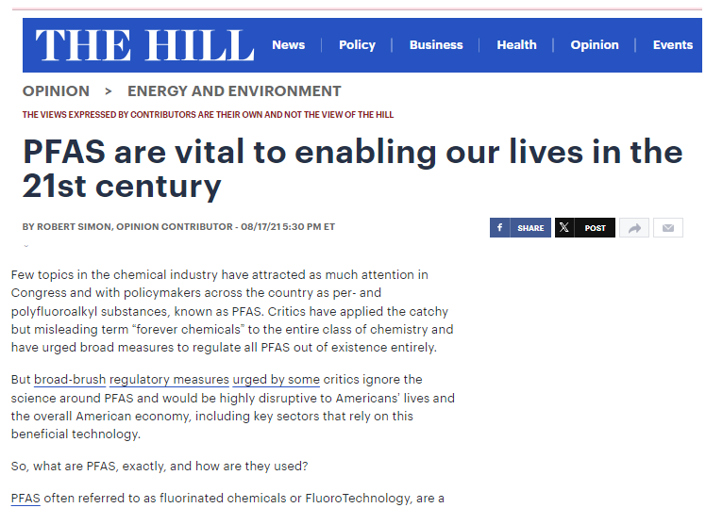
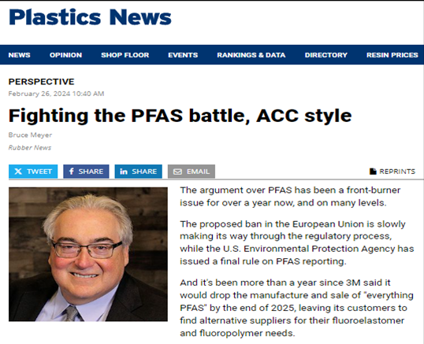
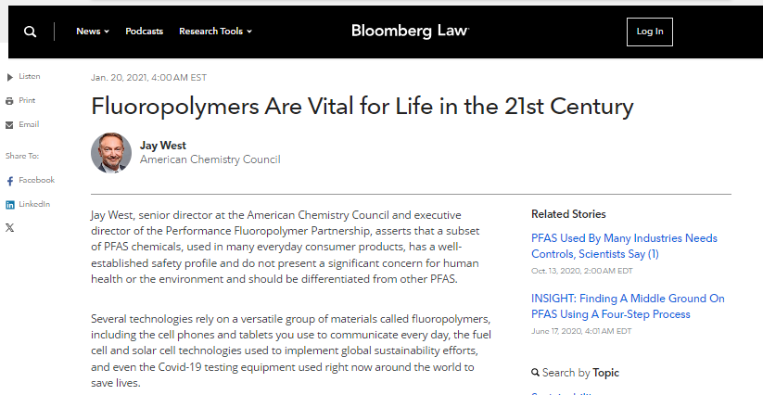
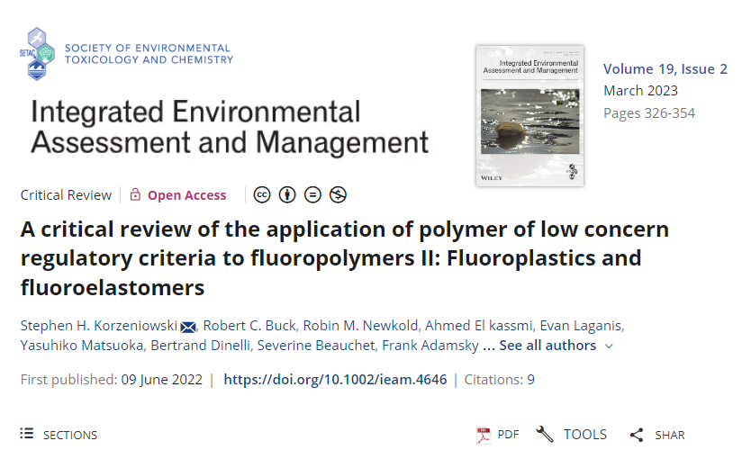
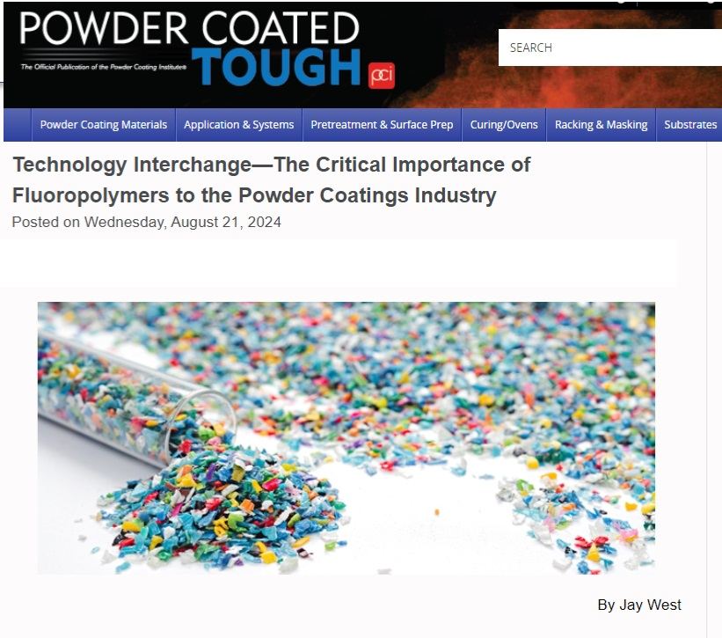
Conversation: PFP-Sourced Media Articles
Jay West Op-Ed on PLC Study
Rob Simon Op-Ed on PFAS Regulation
Plastics News Column on PFP, Fluoropolymers
Jay West Op-Ed on Fluoropolymers in Modern Life
PFP Manuscript on Polymer of Low Concern Criteria
Jay West Article on Fluoropolymer Use in Powder Coatings

Slide 6
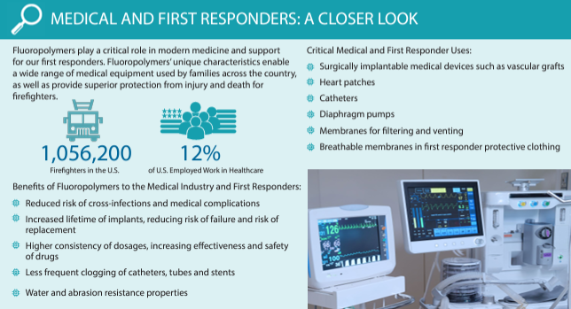
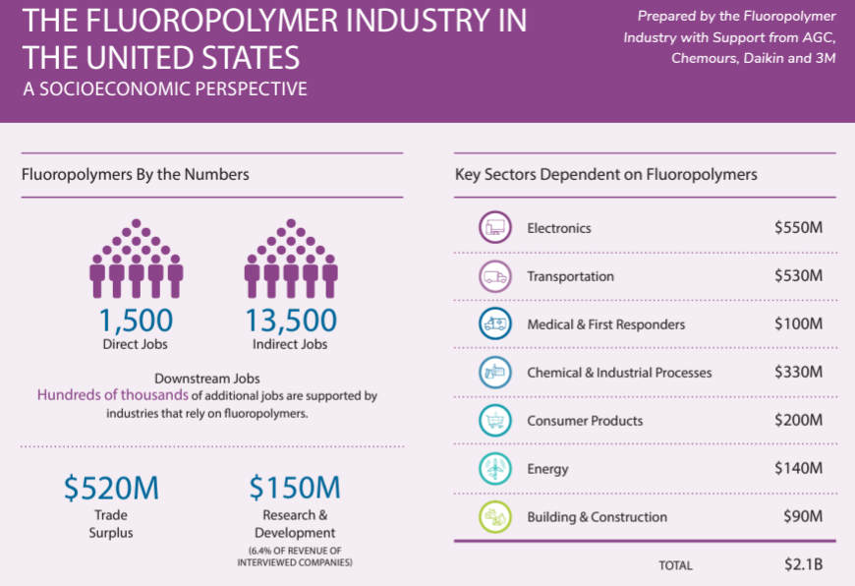
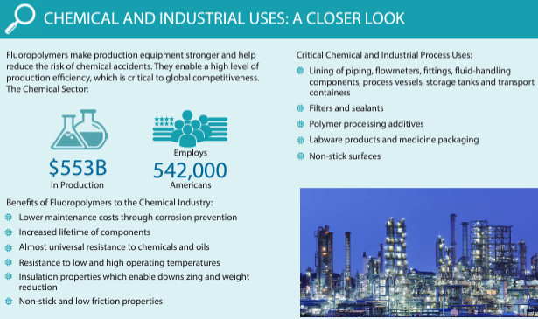
Impact: Infographics and One-Pagers
Medical and First Responder Sector
Transportation Sector
Electronics Sector
Consumer Products Sector
The Fluoropolymer Industry in the United States: A Socioeconomic Perspective
Chemical and Industrial Sectors
Energy Sector

Slide 7
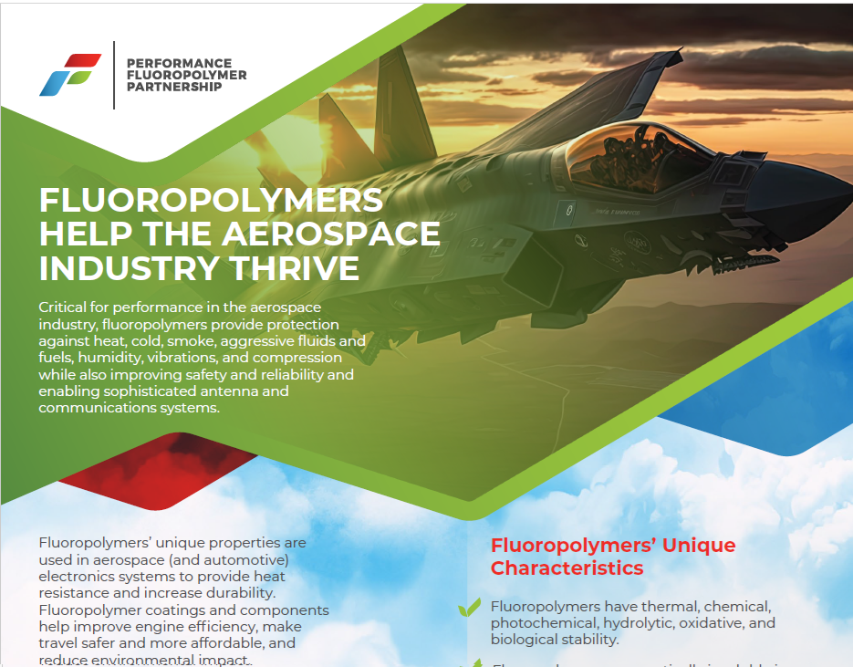
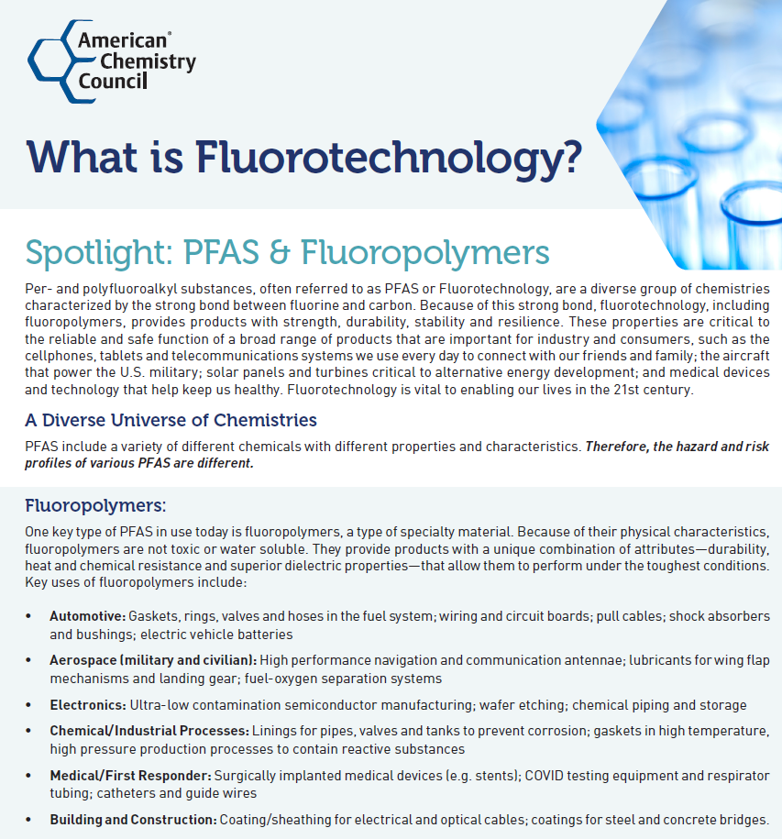
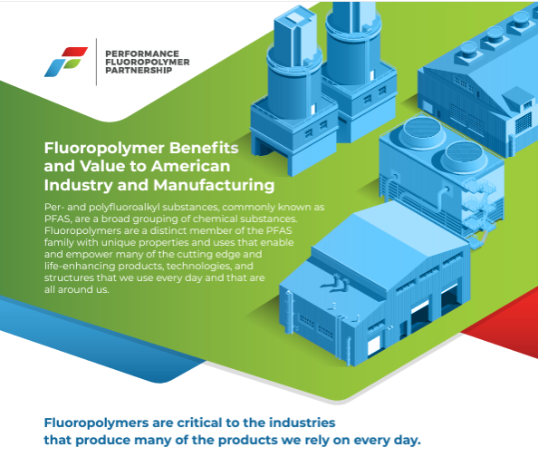
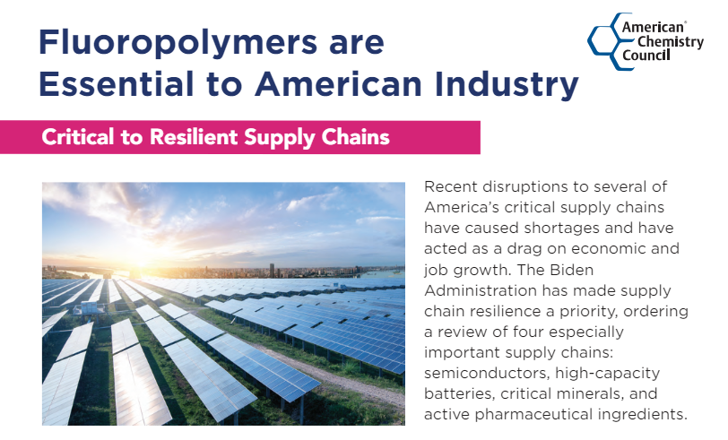
Impact: Infographics and One-Pagers
Fluoropolymers Help the Aerospace Industry Thrive
What is Fluorotechnology ?
Differentiating Fluorinated Polymers
Fluoropolymer Benefits and Value to American Industry
Fluorotechnology Makes Possible Important Products
Fluoropolymers: Essential to America’s Supply Chains

Slide 8
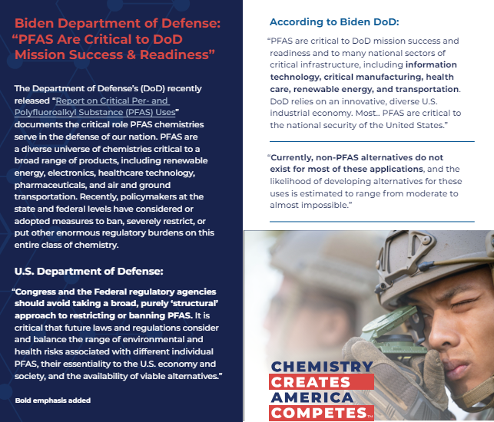
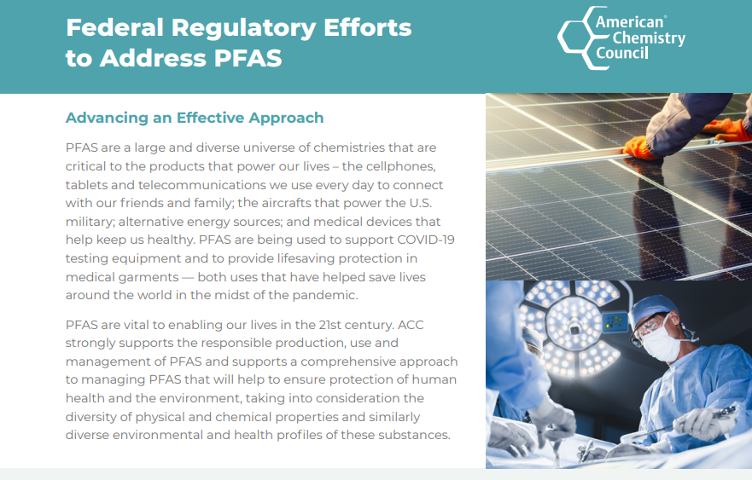
Impact: Infographics and One-Pagers
DoD: "PFAS Are Critical to Mission Success"
Fluorotechnology Enables Life in the 21st Century
Federal Regulatory Efforts to Address PFAS
Frequently Asked Questions About PFAS

Slide 9
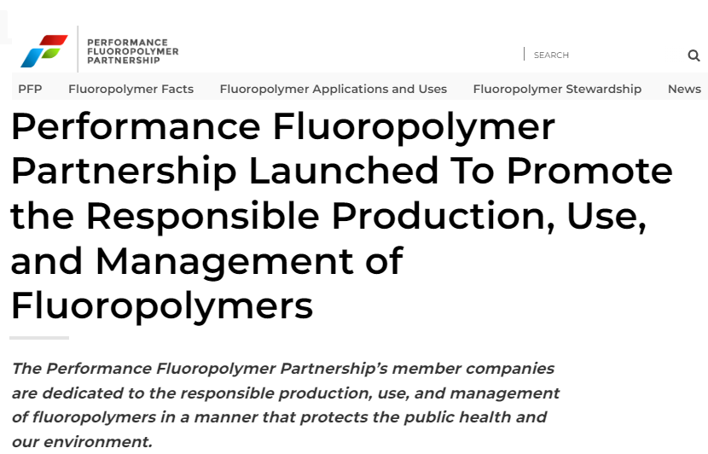
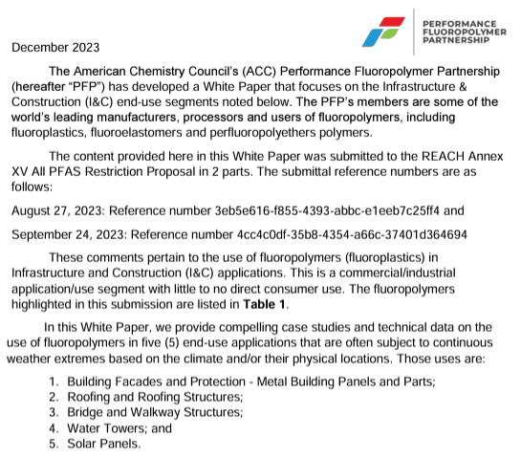
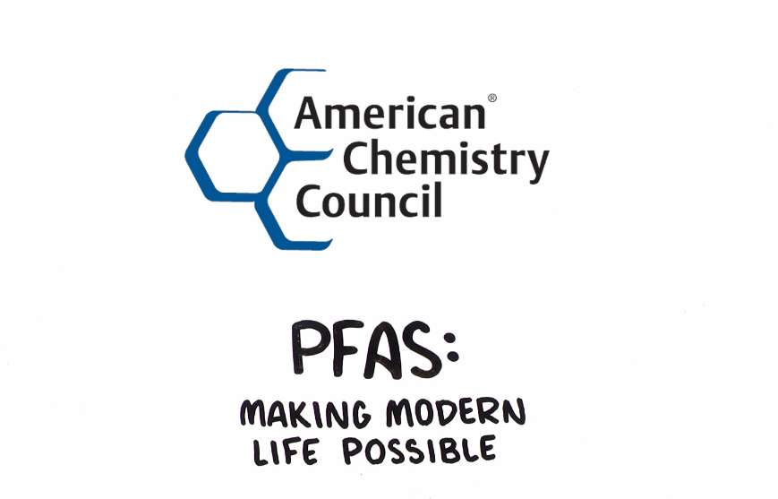
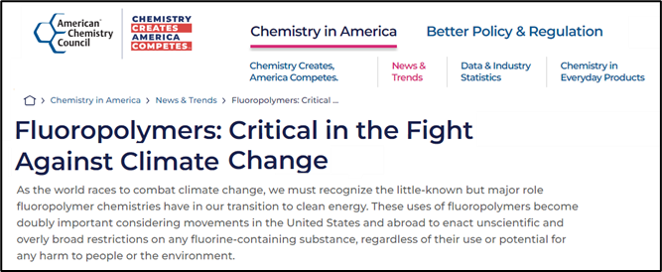
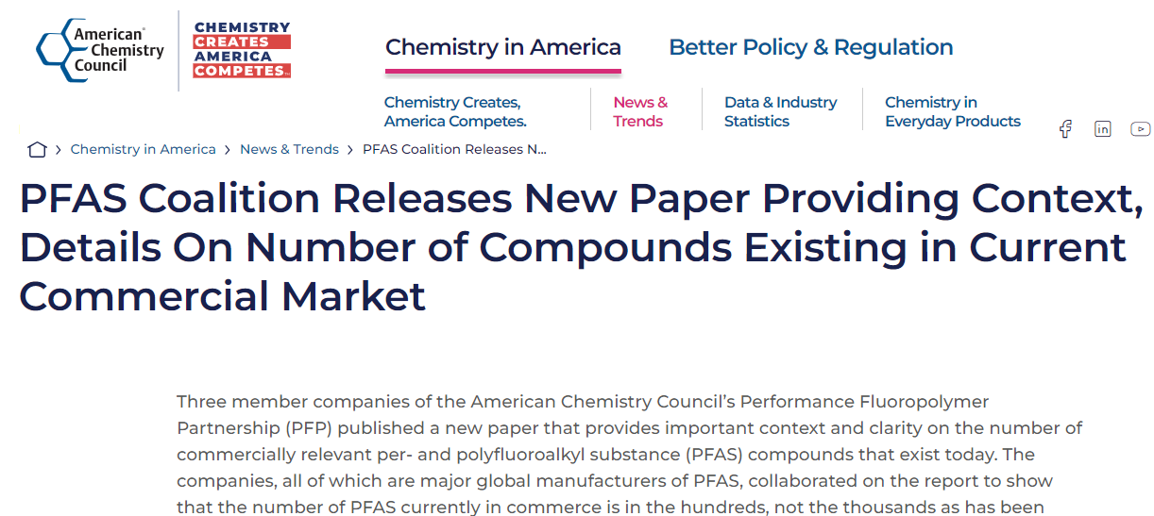
Engagement on Fluoropolymers and PFAS
Official Statements:
Proposed PFAS Legislation in Rhode Island Poses Significant Threat To Chemistries Critical to Residents and Businesses in the State
Launch of PFP Organization Announcement
CA Legislation Stifles Innovation, Negatively Impacts Key Sectors of the Economy: Aerospace, Semiconductors, Clean Energy, Electronics, Medical, Industrial Processes
Video – PFAS: Making Modern Life Possible
Proposed PFAS Ban Would Create Major Problems for Colorado
Fluoropolymer Use In Infrastructure and Construction
PFP Manuscript on Polymers of Low Concern
PFP Manuscript on Commercial Inventory of FPs
PFP Blog on Importance of FPs to Sustainability
Frequently Asked Questions About PFAS

Slide 10
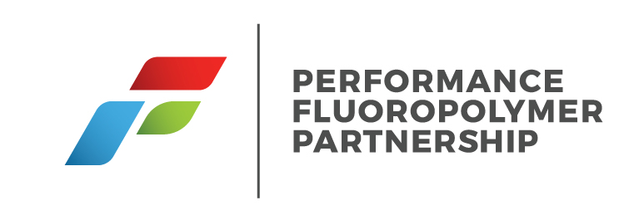
Contacts
Industry Group
Jay West, Executive Director
202-249-6407
Jay_West@americanchemistry.com
For More Information:
The Performance Fluoropolymer Partnership Website
ACC Website Page on PFP
ACC Website Page on Fluoropolymer Chemistry
ChemicalSafetyFacts.org – Fluorinated Chemistries
Plastics Industry Association – Fluoropolymers Division
Fluoropolymer Product Group (Plastics Europe)
Media Contact
Erich Shea, Communications Director
202-249-6510
Erich_Shea@americanchemistry.com

